Slide 1
Forest Ridge Ward Announcements
WELCOME

Slide 2
Relief Society Campout
RELIEF SOCIETY
October 9 – 10
Camp Thunder Ridge
32701 E 660 Rd, Chouteau, OK 74337
FOREST RIDGE WARD

Slide 3
Single Adult Fireside
YOUNG SINGLE ADULTS
October 18 — 6:30 PM
Owasso Building
Tacos provided; bring sides and desserts
FOREST RIDGE WARD

Slide 4
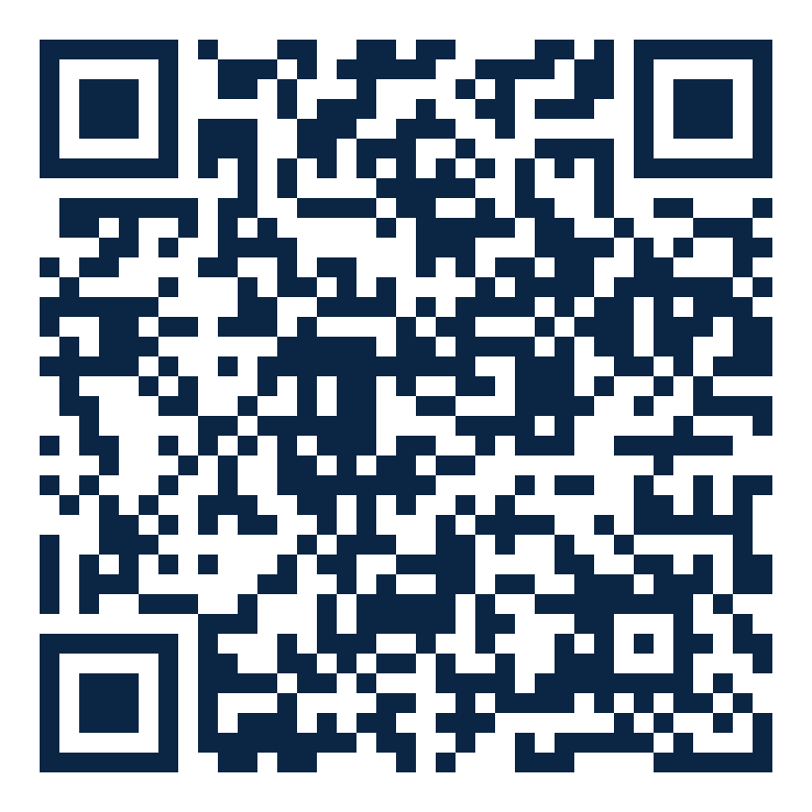
Ward Temple Trip
TEMPLE WORSHIP
October 24 — 10:00 AM
Oklahoma City Temple
Scan to schedule
FOREST RIDGE WARD

Slide 5
Feed Our Missionaries
SERVICE
Sister Hulsey
918-706-3296
Call or text to sign up
FOREST RIDGE WARD

Slide 6
Have an Announcement to Add?
SUBMIT AN ANNOUNCEMENT
Kyle Emler
918-869-3508
kyleemler@gmail.com
FOREST RIDGE WARD

Slide 7
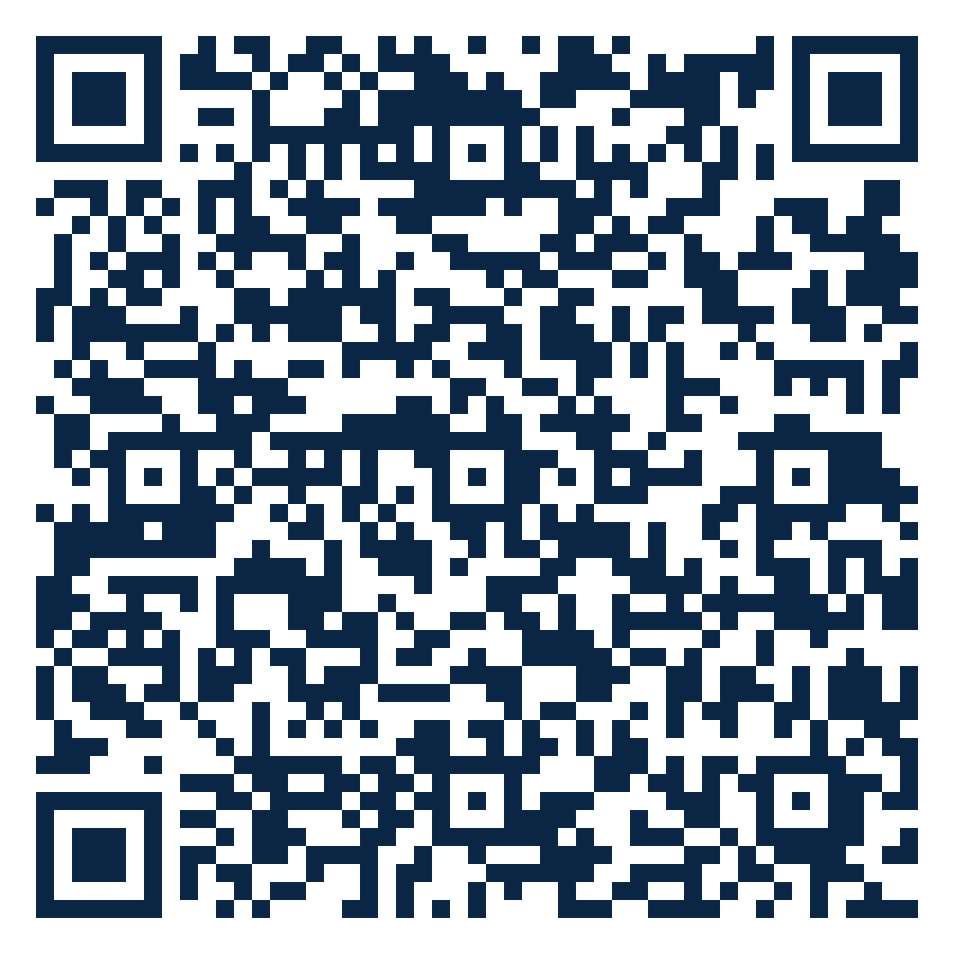
All Ward Announcements
STAY CONNECTED
Scan for every announcement in one place
FOREST RIDGE WARD

